Slide 1
Draft Regulation on Connectivity & GNA
Key Observations
07-03-2022
Sharat Ranjan - Ayana Renewable Power Pvt Ltd

Slide 2
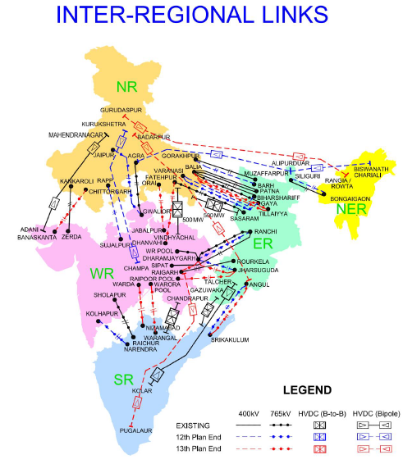
GNA Concept
There is Peak deficit in Summer Peak, Winter Peak and Monsoon Peak in Northern Region and Southern Region which leads to congestion in Corridor.
The inter regional total transmission capacity (TTC) is 105,050 MW as on 30th Jan 2022. However, the available transmission capacity (ATC) on daily basis is not exceeding 35% of TTC and the actual usage is around 25%. – Why GNA is restricted to Regions when the usage is so less
Total Inter- regional capacity target is 1,26,650 MW at end of 13th plan (2017-22) and the achievement is 83%

Slide 3
GNA Issues impacting
Issues | Proposed Solutions
Entities covered under Regulation 4.1 and clause (iii) of Regulation 17.1 of these regulations shall furnish one-time GNA charge for Rs. One lakh per MW for the quantum of GNA one month prior to the start date of GNA. | It should not be applicable to existing Connectivity holders and that transition to GNA should happen without any commercial impact.
Quantum of Connectivity for Round the Clock Bids and Peak Power Requirement Bids | Hon'ble commission may provide the clarification on the same. We propose it to be Maximum injection quantity to ISTS.
Any augmentation required, excluding terminal bay(s), to the existing ISTS identified under Regulation 6.1 of these regulations, shall be considered as the Associated Transmission System (ATS) for the Applicant(s). | Associated Transmission System should be identified in advance for each of the substation so that the Generators are aware of the additional charges/BG charges required for the connectivity

Slide 4
GNA Issues impacting
Issues | Proposed Solutions
(a) All the State DISCOMs connected to ISTS will be considered as deemed grantee of GNA, and the GNA of a State on the date the 2021 Draft GNA Regulations come into force, shall be based on average of actual ISTS drawal during the last three years as per the proposed formula since the drawal represents the usage of ISTS by the State. | As the Demand of the states are going to go up on the coming years due to multiple reasons, the GNA of the states can be considered on higher side to accommodate and meet the extra demand coming from the other segments
Connectivity Bank Guarantee shall be submitted by an Applicant in three parts, Conn-BGl amounting to Rs. 50 lakhs, and Conn-BG2 and Conn-BG3, as provided in Regulations 8.2 and 8.3 of these regulations. | We propose to remove the requirement of Conn­BG 2 where the PPA signing entity is Central Govt. Entity/ Central Govt. REIA (SECI/NTPC/NHPC) or a State Govt. Entity/ State DISCOM/ Distribution Licensee

